Slide 1
MYJOBs
Service provider & seeker
The perfect

Slide 2
Abstract
MyJobs is a user-friendly web application designed to bring together services and workers seamlessly. Services register using their email and password, providing essential details such as their name, phone number, and other details. Upon registration and verification, services can create job posts detailing specific work requirements. These posts are then made available to workers. Individuals can browse through the latest job posts and apply for those that interest them by providing their name, contact information, location, and resume or other necessary documents. Once an individual applies, the service reviews the information and decides whether to approve or reject the applicant for the specific job. This platform simplifies the process of finding jobs and workers, ultimately enhancing the job sector.

Slide 3
table of contents
01
02
03
INTRODUCTION
Modules
Software specification
04
05
06
Existing system
Advantages
Conclusion
What is MyJob How its Works
Main 3 modules describe
Application used programs
Problems of Previous System
Describe the benifts of our application
How this application make future better

Slide 4
01
INTRODUCTION
What is MyJobs How its Works.

Slide 5
Platform Focus: Our platform focuses on creating a user-friendly website or app where all services and workers converge.
Account Creation: Services can sign up using their email and password. They are required to share basic details such as their name, phone number, and picture for public visibility.
Job Post Creation: Once registered and verified, services can create job posts for workers. These posts include essential details such as event location, date and time, requirements, wages, and the number of workers needed.
Post Confirmation: After confirmation, these job posts are displayed to the workers.

Slide 6
Individuals' View: Individuals can view the latest job posts on the platform.
Browsing and Selection: Individuals can browse through these posts and express interest by either clicking on the post or selecting "Accept.“
Worker Information Submission: Upon accepting a job, individuals are required to provide their name, contact information, location, resume, or other necessary documents.
Confirmation by Service: The service receives this information and confirms whether the worker is needed for the job.

Slide 7
Post Deletion: Once the required number of workers is reached, the post can be deleted from the platform.
Simplified Job Search: This platform streamlines the process of finding jobs and workers, contributing to overall improvements in the job sector.

Slide 8
02
Modules
Main 3 modules describe

Slide 9
MODULES
ADMIN
SERVICE
Worker

Slide 10
admin
Login
View and Manage Service
View and Manage Workers
View and Manage Job Post
View Applications
View Complaints
Send Enquiry to Service
View Reply

Slide 11
Service
Register
Login
Manage Profile
Post and View Job
View And Manage Application
Payments
View Complaint and Reply
Message to Worker

Slide 12
Workers
Register
Login
Manage Profile
View Jobs
View Application Status
View Payment Info
Post Complaint
View Message
Work History

Slide 13
03
Software specification
Application used programs

Slide 14
One of the most difficult tasks is selecting software, once the system requirement is find out then we have to determine whether a particular software package fits for those system requirements. This section summarizes the application requirement.
• Platform : Web application
• Front End : html,CSS, JavaScript
• Back End : MySQL Sever, Python Django
• IDLE Used : Python 3.6 or above
: JetBrains PyCharm

Slide 15
04
Existing system
Problems of Previous System

Slide 16
Problem faced on existing system
6. Inability to Report Fraud Complaints
7. No Worker Rating System
8. Lack of Work History Visibility
9. Complex User Interface
10. Lack of Location Search for Nearby Jobs
1. Lack of Proper Validation for Job Providers
2. Uncertainty about Worker Commitment
3. Outdated Job Postings
4. Limited Communication from Service Providers
5. No Proper Payment Mechanism

Slide 17
05
Advantages
Describe the benifts of our application

Slide 18




Benefits of our application
Job Discovery Streamlined Verification
Good User Interface Fraud Prevention
Trust and Accountability Wider Reach

Slide 19
06
Conclusion
How this application make future better

Slide 20

conclusion
The creation of a user-friendly platform for part-time job services can have a significant positive impact on the industry. It simplifies the process for workers to find opportunities and for employers to locate reliable workers. This proposal outlines the key features and benefits of the platform, setting the stage for its development and deployment to improve the part-time job market.

Slide 21
Data Flow Diagrams

Slide 22
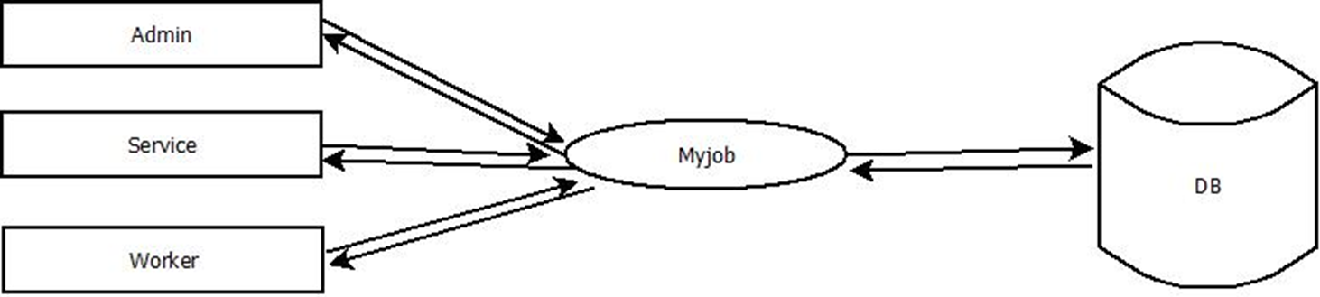
Level 0

Slide 23
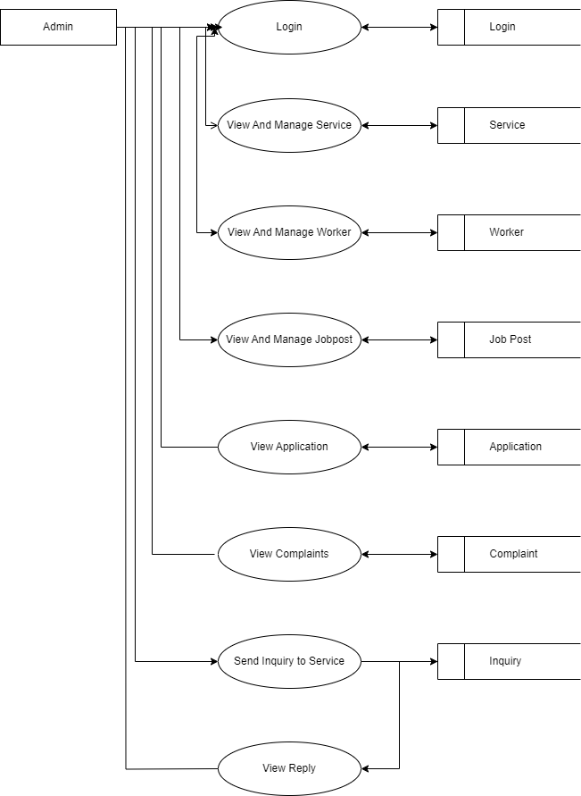
Level 1

Slide 24
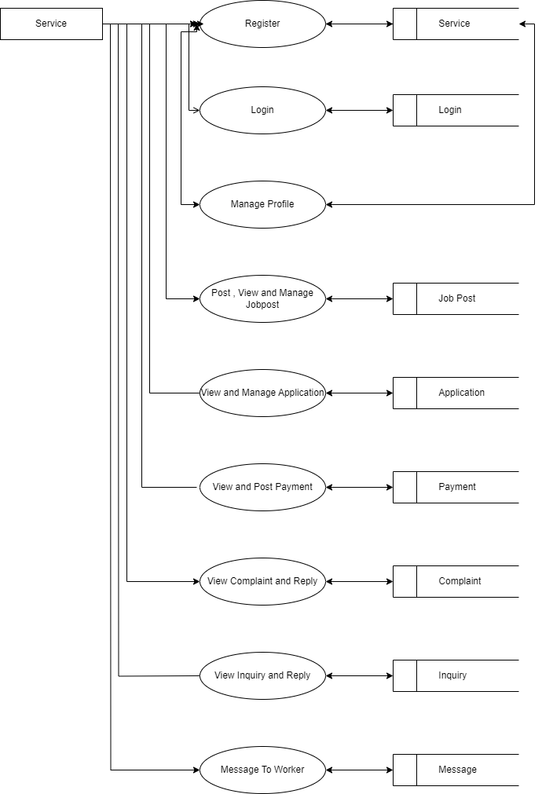
Level 1.1

Slide 25
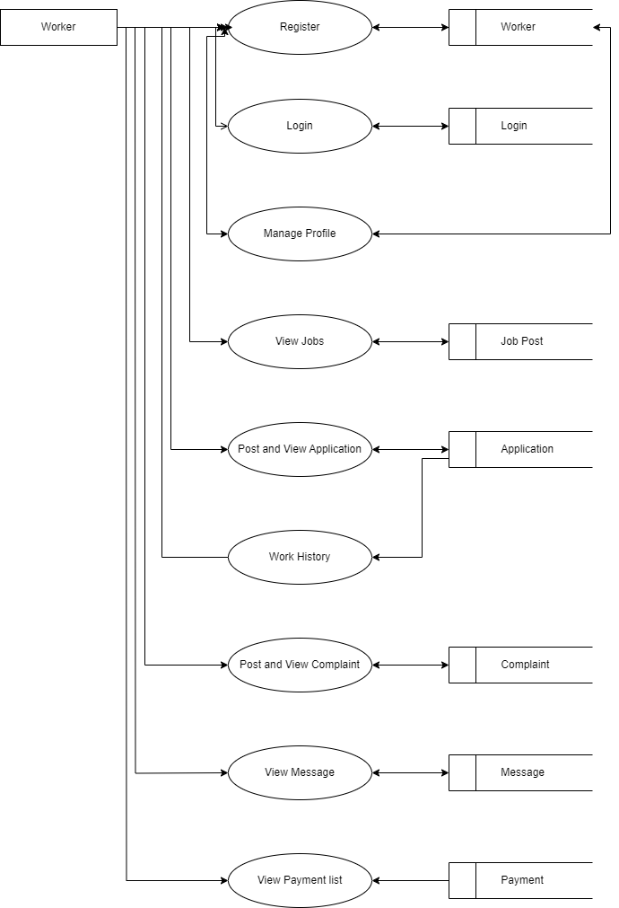
Level 1.2

Slide 26
USECASE DIAGRAM

Slide 27
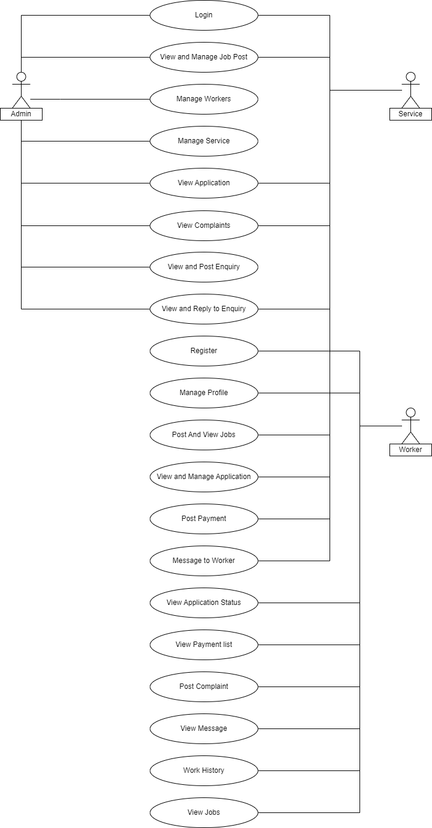
USECASE

Slide 28
ER DIAGRAM

Slide 29
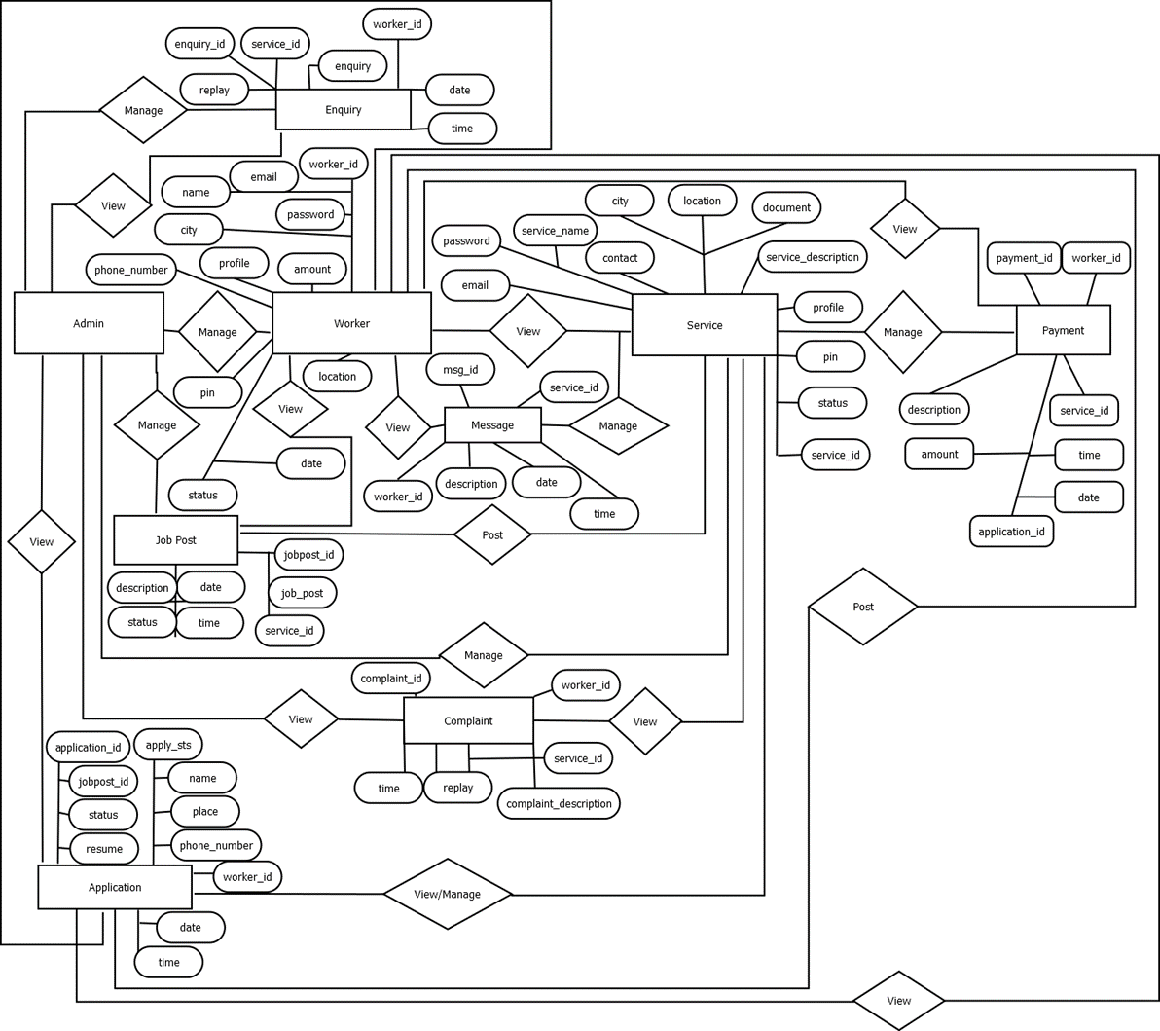

Slide 30
TABLES

Slide 31
APPLICATION
application_id | Integer | Primary key | Auto Increment
jobpost_id | Integer
status | Varchar(45)
Resume | Varchar(60)
Apply_sts | Varchar(45)
Name | Varchar(45)
place | Varchar(45)
Phone_number | Varchar(45)
Worker_id | Integer
date | DATE
time | TIME

Slide 32
cOMPLAINT
Complaint_id | Integer | Primary key | Auto Increment
Worker_id | Integer
Service_id | Integer
Complaint_description | Varchar(200)
replay | Varchar(200)
Date | DATE
Time | TIME

Slide 33
ENQUIRY
enquiry_id | Integer | Primary key | Auto Increment
Worker_id | Integer
Service_id | Integer
Enquiry | Varchar(45)
Replay | Varchar(200)
Date | DATE
Time | TIME

Slide 34
JOB POST
Jobpost_id | Integer | Primary key | Auto Increment
Job_post | Integer
Service_id | Integer
description | Varchar(200)
status | Varchar(25)
Date | DATE
Time | TIME

Slide 35
LOGIN
login_id | Integer | Primary key | Auto Increment
Username | Varchar(45)
Password | Varchar(45)
Type | Varchar(45)
u_id | Integer

Slide 36
MESSAGE
Msg_id | Integer | Primary key | Auto Increment
Service_id | Integer
Worker_id | Integer
Description | Varchar(200)
date | DATE
time | TIME

Slide 37
PAYMENT
Payment_id | Integer | Primary Key | Auto Increment
Worker_id | Integer
Service_id | Integer
Description | Varchar(200)
Amount | Varchar(45)
Application_id | Integer
Date | DATE
Time | TIME

Slide 38
SERVICE
Service_id | Integer | Primary key | Auto Increment
Email | Varchar(45)
password | Varchar(45)
Service_name | Varchar(45)
Service_description | Varchar(45)
Contact | Decimal(10,0)
City | Varchar(45)
Document | Varchar(250)
Location | Varchar(45)
Profile | Varchar(250)
Pin | Varchar(45)
Status | Varchar(45)

Slide 39
WORKER
Worker_id | Integer | Primary key | Auto Increment
Name | Varchar(45)
Email | Varchar(100)
Password | Varchar(100)
City | Varchar(100)
Amount | Varchar(45)
Phone_number | Varchar(45)
Profile | Varchar(250)
Pin | Varchar(45)
Location | Varchar(45)
Status | Varchar(45)
date | DATE

Slide 40

Samble Screen shots

Slide 41

Home page

Slide 42
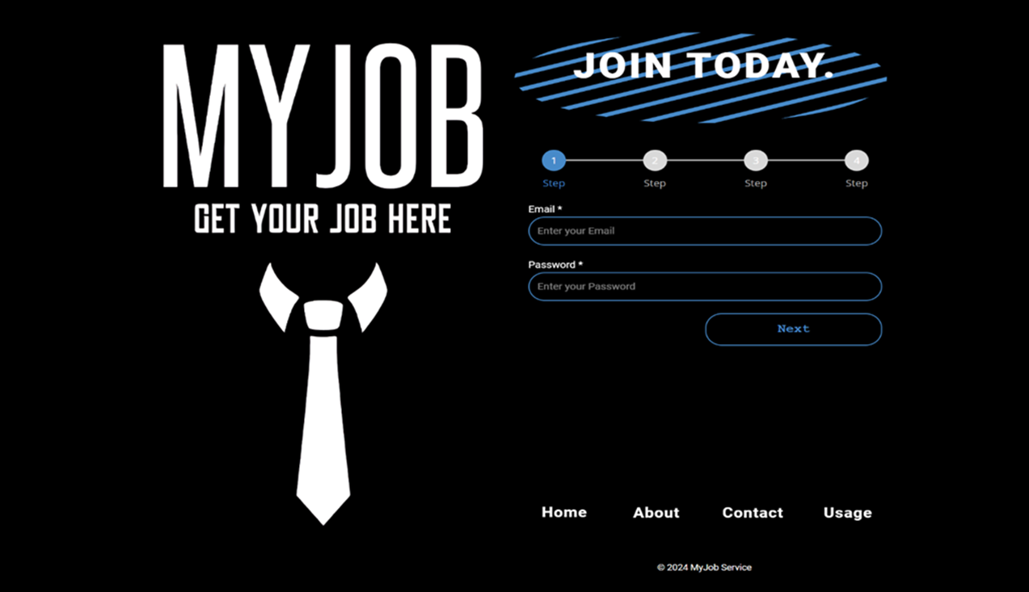
Service registration page

Slide 43
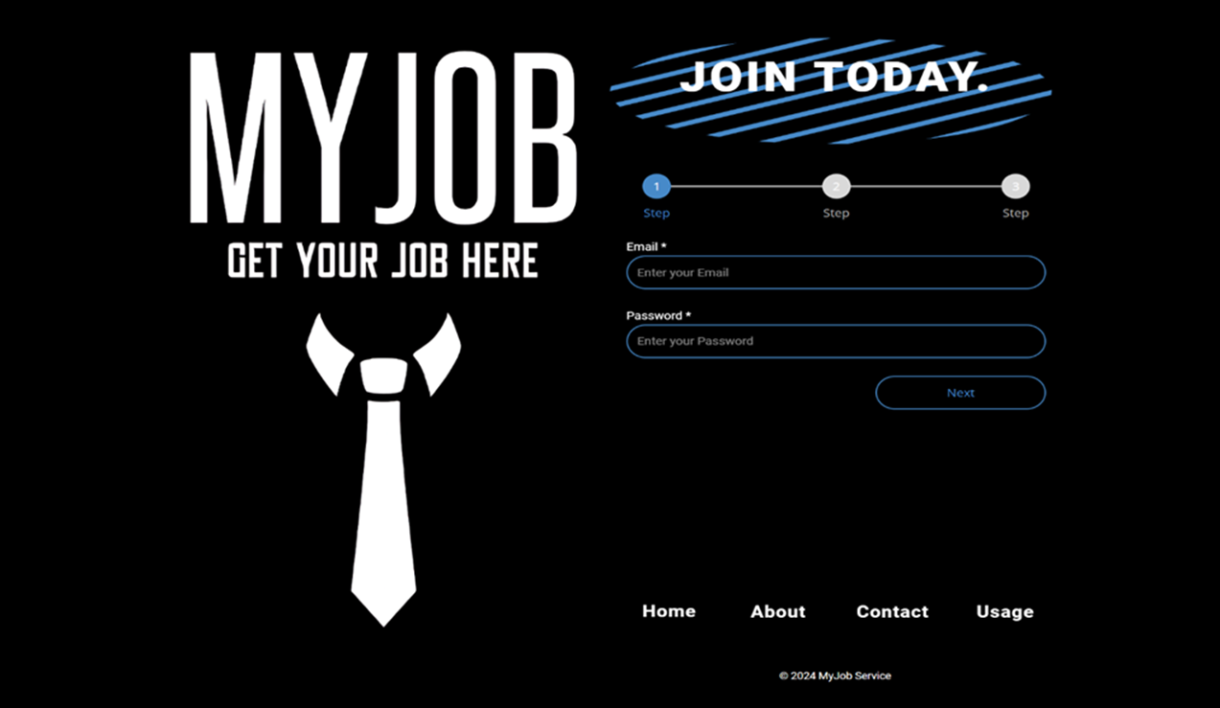
worker registration page

Slide 44

Login page

Slide 45
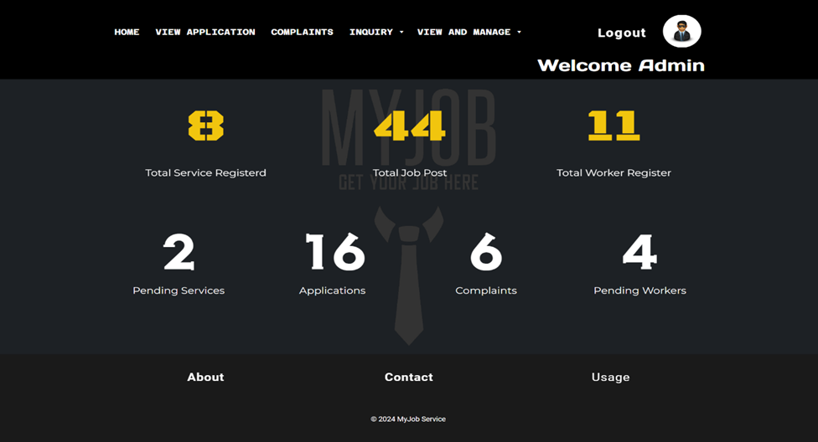
Admin Home Page

Slide 46
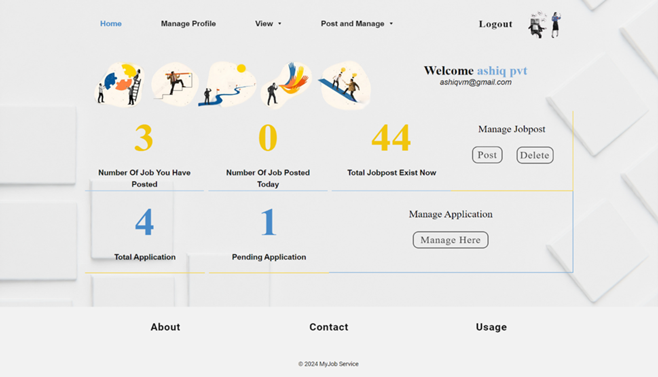
Service home page

Slide 47
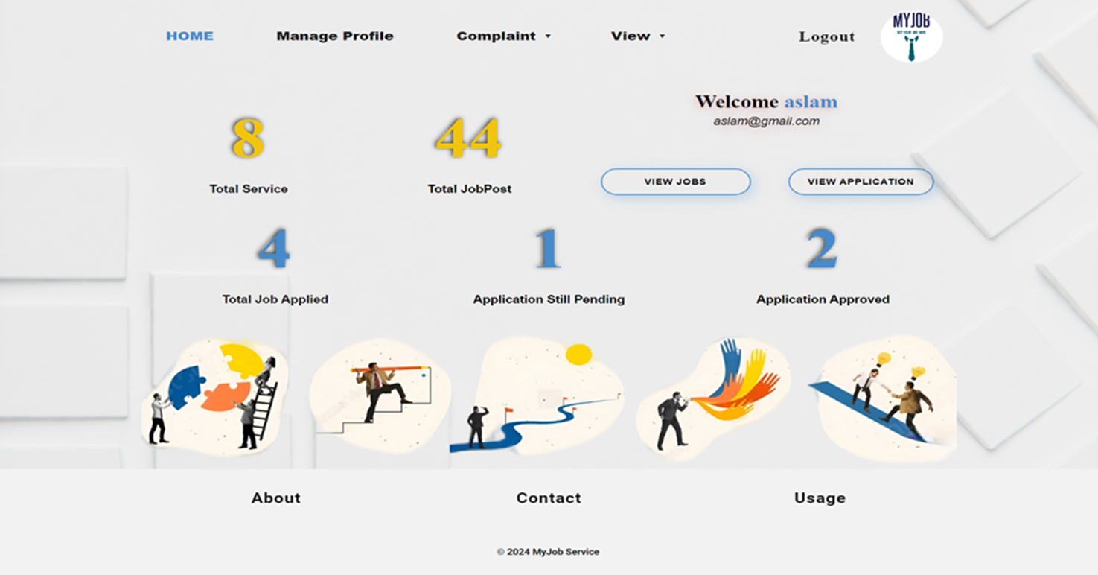
worker home page

Slide 48
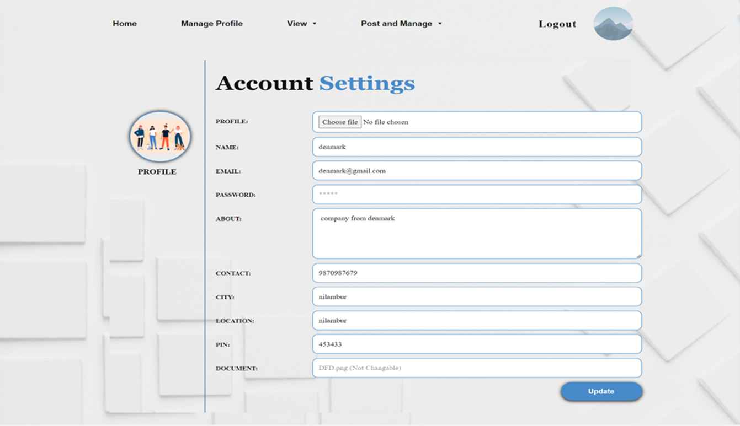
Manage profile

Slide 49
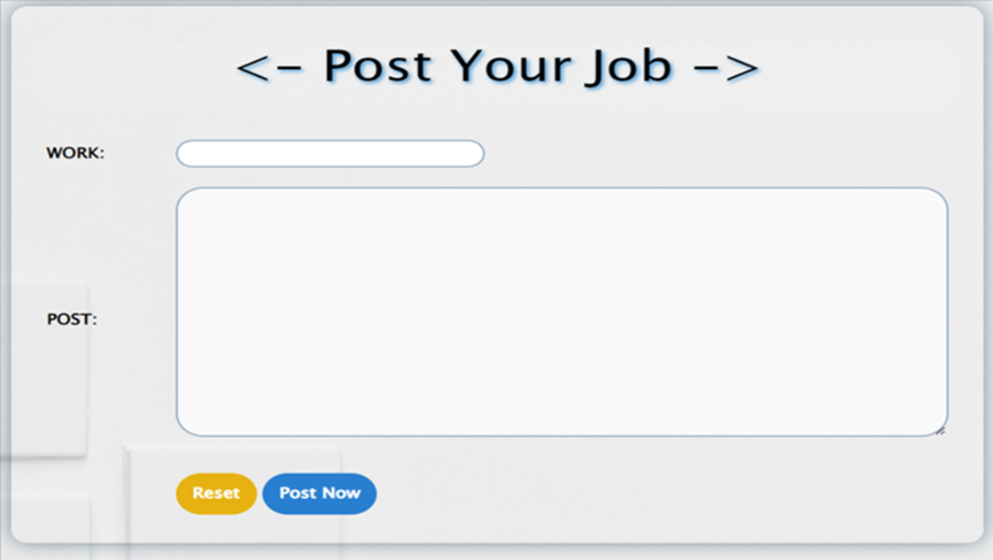
Post job

Slide 50
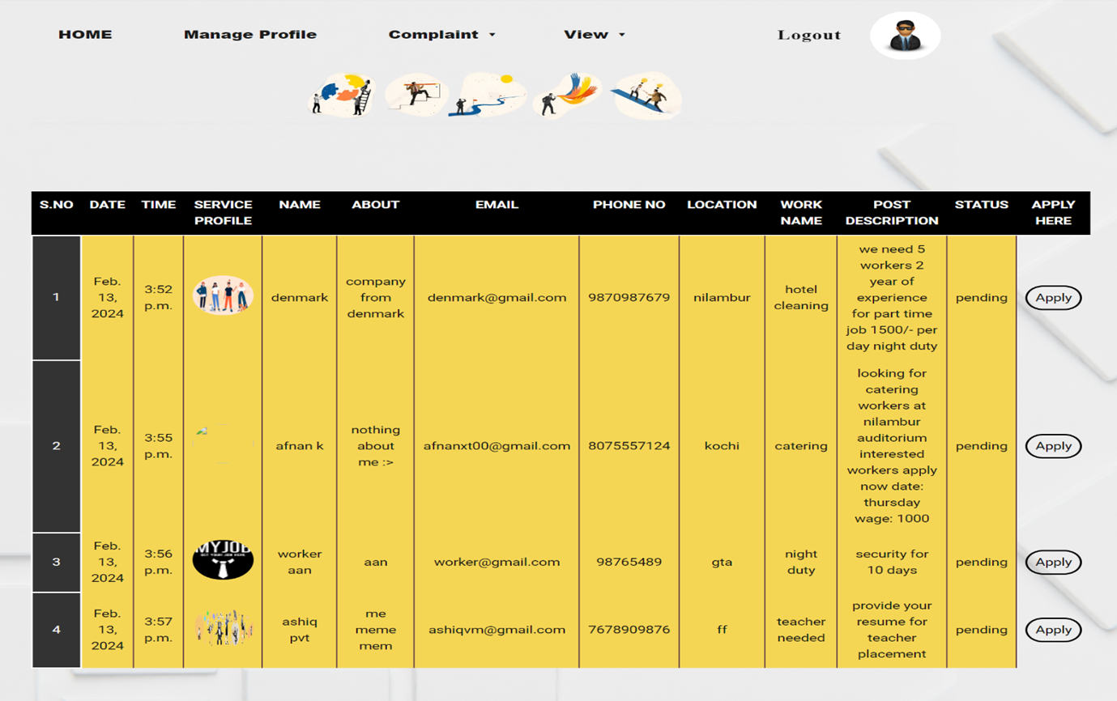
View jobs

Slide 51
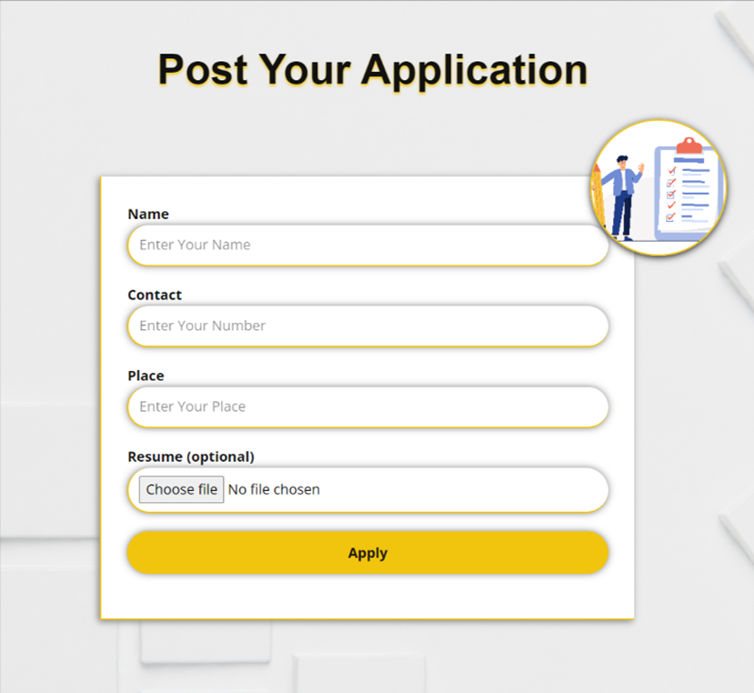
Post application form

Slide 52
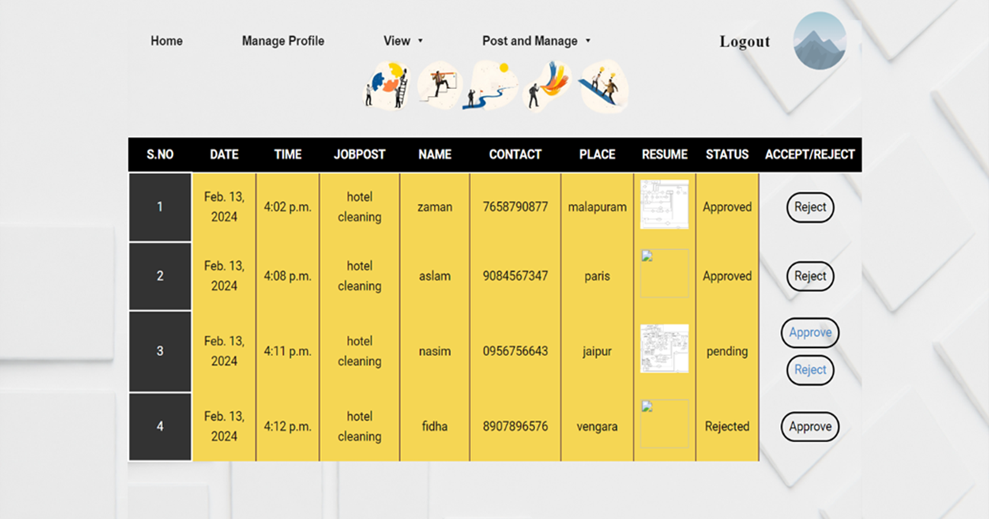
Manage application form

Slide 53
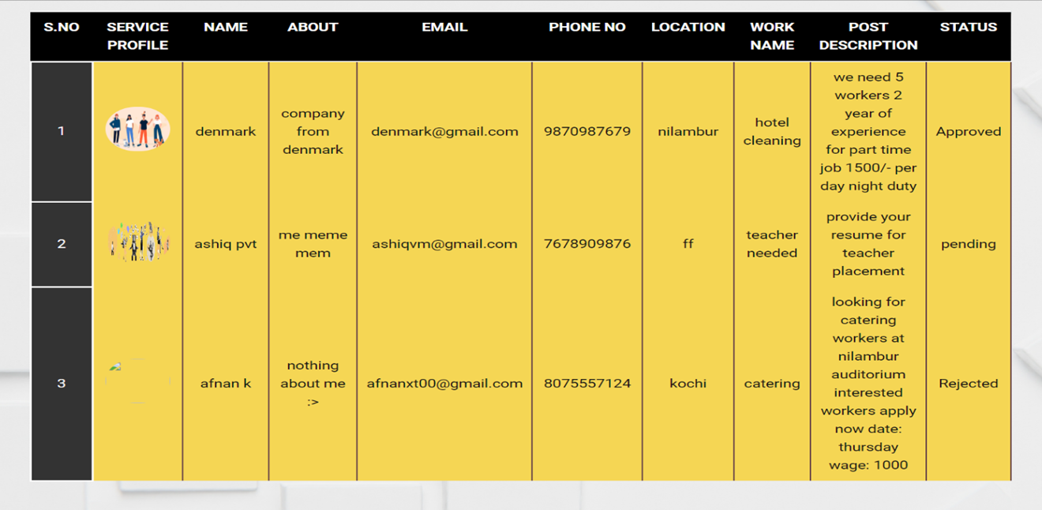
View worker application

Slide 54
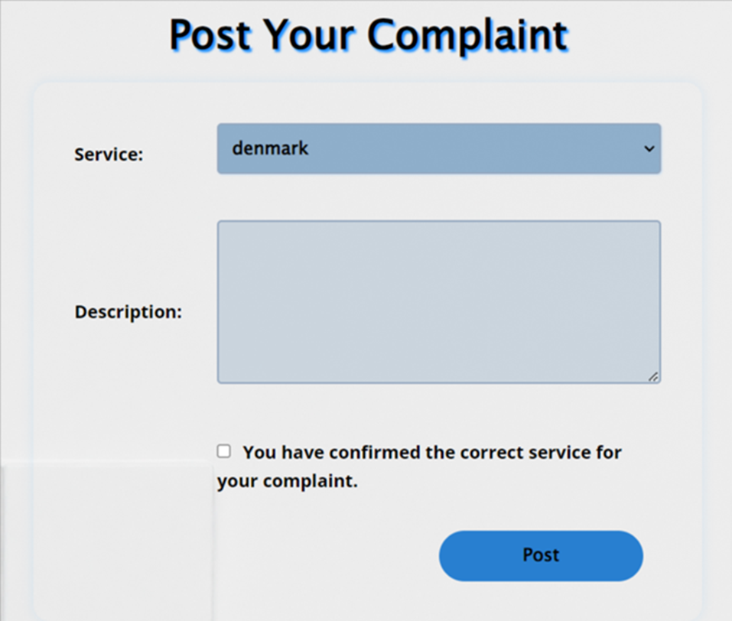
Post complaint

Slide 55
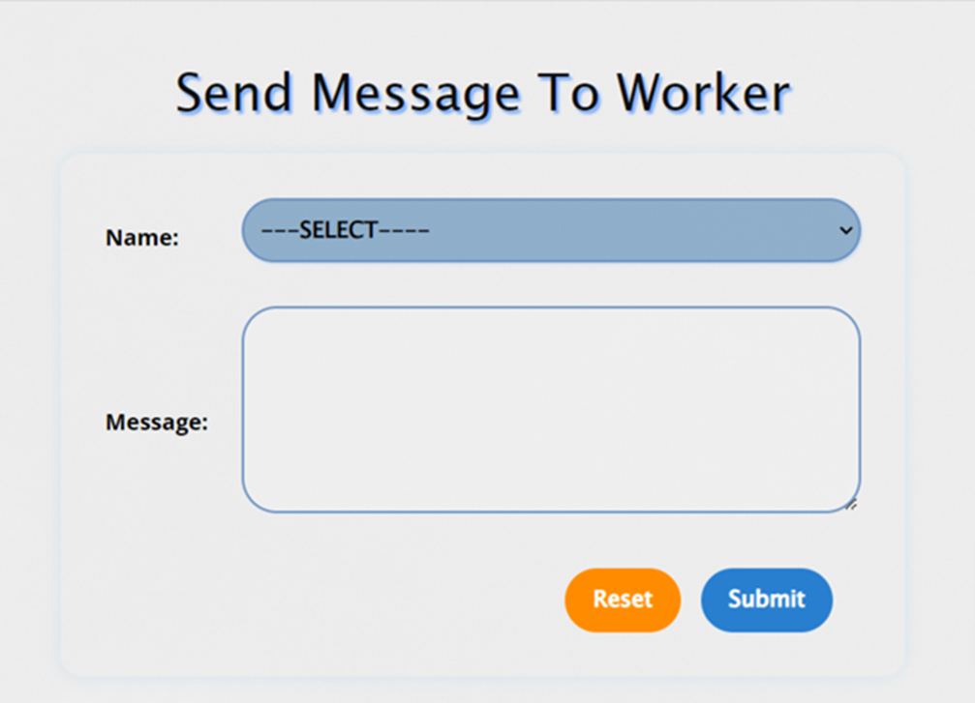
Post message to worker

Slide 56
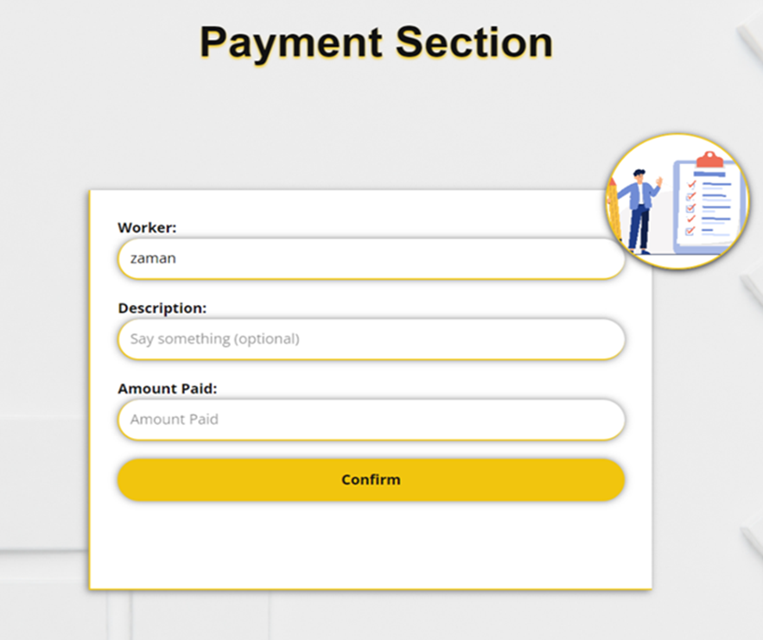
Post payment

Slide 57

THANKS!
Team Mentor
Sir
Team Members
Afnan
Mr
Mrs
mrs
Please keep this slide for attribution

